Slide 1
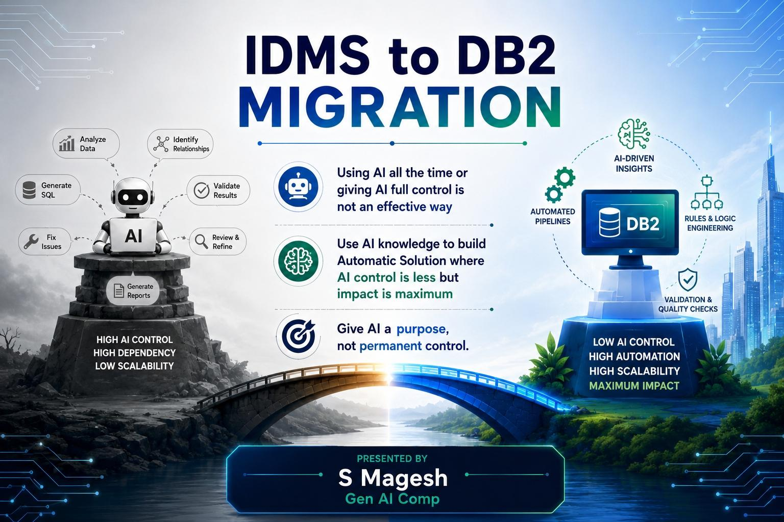

Slide 2
KASBON IDMS to DB2 Migration
Our Journey from Exploration to AI-Powered Solution
Agenda
Use Case Discovery
Understanding the manual migration landscape and identifying AI automation opportunities
Problem Statement
Defining the migration challenges, business constraints, and modernization objectives
AI Solution Framework
Designing the approach to address key migration challenge
6-Week Exploration: A Case Study
Evaluating and experimenting with different AI-driven approaches
Solution & Customer Value
Translating our learnings into AI solutions, reduced effort, and cost optimization
Live Demo
Demonstrating the AI-driven migration approach and automation in action
FAQ & Discussion

Slide 3
Use Case Discovery - KASBON IDMS to DB2 Migration Current Manual Process
Categories | Activity | Current | Plan
IDMS Database Analysis | Analyze IDMS Schema & Business Rules | Manual Analysis | AI
 | SME Validation | Manual Process
DB2 Database Design & Creation | IDMS → DB2 Mapping | Manual Process | AI
 | Design DB2 Schema - Define Transformation Rules | Manual Process | AI
 | Create DB2 Data Model & Tables | Hopex Tool
Data Migration & Sync-up | IDMS Data Unload | Reusable Program & JCL
 | Transform & Sync Data for DB2 | Reusable Program & JCL
 | DB2 Data Unload | DB2 Utility
 | Compare IDMS & DB2 Data | Reusable Program & JCL | AI
Application Development | Analyze IDMS Programs & Define DB2 Specification | Manual Process | AI
 | Add Switch Logic - Convert IDMS Calls to DB2 | REXX Script
 | Compare IDMS & DB2 Output | Reusable Program & JCL | AI
 | Update JCL for DB2 | REXX Script
Testing | Unit Testing | Manual Process | AI
 | Integration & Performance Testing | Test Automation | AI

Slide 4
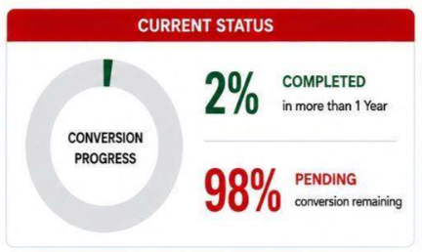
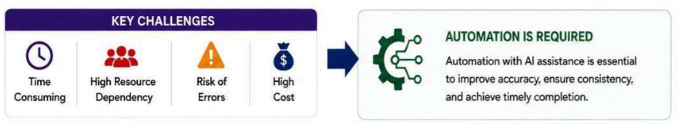
Problem Statement - KASBON IDMS to DB2 Migration – Manual Process
Legacy Data Model — Convert the IDMS network database model into a relational DB2 model
COBOL Logic Preservation — Retain the existing COBOL business logic, while modernizing only the database access layer
License & Support Constraints — IDMS licensing and support limitations are driving the need for modernization
Data & Business Rule Transformation — Significant differences between IDMS and DB2 :
  Network → Relational Model Transformation
  Business Rules & Referential Integrity
  Primary, Composite & Foreign Key Mapping
  Data Types, Formats & Length Mapping
  Data Transformation & Compatibility
  COBOL Database Access Conversion
  Legacy Naming → DB2 Naming Standards
  Data Validation & Reconciliation

Slide 5
AI-Based Solution Frameworks
 | 1. Agentic AI | 2. AI-Driven Workflow | 3. AI-Assisted Automation
Solutions | Goal → Planning → Reasoning → Execution | Instructions + Business Rules → Reasoning → Execution | AI Knowledge → Rules → Deterministic Automation
AI Role | AI controls the end-to-end process | AI reasons and executes within defined instructions | AI helps discover rules; automation executes them
Key Benefit | Maximum autonomy | Faster implementation | Lower cost & predictable execution
Key Challenge | Higher cost & less control | Cost & consistency | Higher initial human effort
Best Fit | Dynamic, less rule-bound tasks | Structured workflows requiring AI reasoning | Rule-intensive, repeatable processes
Decision | Not suitable for the current problem due to complex business rules | Selected as Approach 1 — faster to develop and explore | Selected as Approach 2 — deterministic and scalable

Slide 6
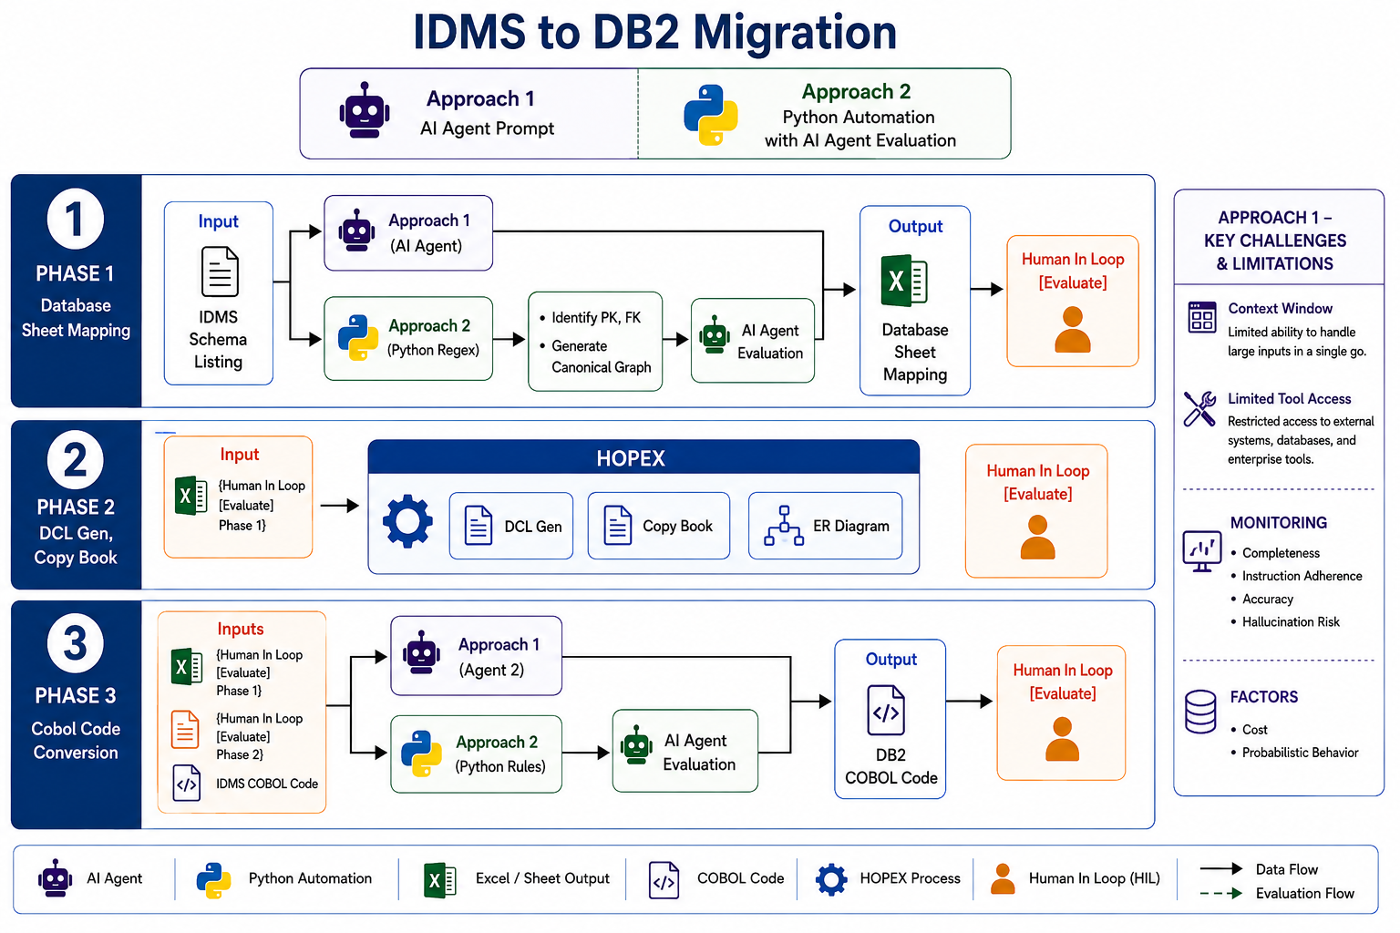
2 Exploration Approaches

Slide 7
KASBON IDMS to DB2 Migration​
Key Challenges and Limitation in Approach 1
Approach 1 — Mistral AI Exploration
  Client Security Constraint — Mistral AI access limited to the approved environment
Challenges Identified — Approach 1, Stream 1: Mistral AI Agent
  Context Window Limitation — Difficulty handling large migration inputs
  Limited Tool Access — Restricted integration with external systems and enterprise tools
  AI Evaluation & Monitoring -
    Completeness — Risk of missing information with large inputs
    Instruction Adherence — Verify consistent adherence to defined instructions
    Accuracy — Validate correctness of generated results
    Hallucination Risk — Identify unsupported or incorrect outputs
Approach 1, Stream 2 — Mistral Endpoint Prototype - Built a prototype using the Mistral Endpoint
UI limitations could be addressed, but two challenges remained:
⚠️ Cost — LLM execution can be expensive at scale
⚠️ Probabilistic Behavior — Outputs can vary, requiring continuous evaluation and validation

Slide 8
6-Week Exploration: A Case Study
KASBON IDMS to DB2 Migration​
 | Approach 1- AI Agents |  |  |  | Approach 2
 | S1: Mistral UI - AI Prompt |  | S2 : Mistral AI End Point |  | Python Automation with AI
Current Status | Iterating on the agent file based on prior feedback. |  | Prototype completed |  | Exploring rules and concepts to improve accuracy.
Environment | Hexaware | Belfius | Hexaware | Belfius | Hexaware | Belfius
Phase 1 - Database Sheet Mapping - Achieved Accuracy
Records, Columns, PK, FK | 65% | - | 70% | - | 70% | -
Compositive Key, Date, Business rules | - | 50% | - | - | - | 75%
Redine, Occurs | Development Inprogress
Phase2 - Cobol Code Conversion - Achieved Accuracy
Update/Retrieval Program | 60% | - | 60% | - | 65% | -
With DCLgen, Copybook | - | 50% | - | - | - | 70%
Restart Table, LRF | Development Inprogress

Slide 9
Approach 2, Stream 1 — Python Automation with AI Evaluation
AI-assisted rule discovery and evaluation, followed by deterministic Python-based execution.
Customer Value - Creating smiles through great people and technology.
Transforming our exploration into a scalable and sustainable migration solution.
Value | Impact
Reduced Manual Effort | Automate repetitive migration activities
Cost Optimization | Reduce recurring AI and manual processing effort
Improved Consistency | Standardized, deterministic transformation
Faster Migration | Accelerate analysis and conversion activities
Reusable Automation | Build once and reuse validated rules
Scalable Approach | Progressively automate additional migration scenarios

Slide 10
KASBON IDMS to DB2 Migration​
Next Steps & Opportunities
1. Productize Approach 2, Stream 2 — Tool Integration
    Convert validated business rules into reusable automation tools
    Explore Mistral Connectors / MCP for tool integration
    Reduce LLM dependency and optimize execution cost
2. AI for Unexplored / Complex Rules
    Use Mistral Endpoint for unknown or complex rules
    Apply AI selectively for exception handling and rule discovery
    Validate and convert new rules into deterministic automation
Additional Use Cases
    Unit Testing
    Integration Testing
    Data Migration & Synchronization

Slide 11

KASBON IDMS to DB2 Migration​
Open Discussion
AI Engineer Team
Magesh S
Aaron Sam AS
Niraj Fegade
Management Team
Praveen Shetty
Yassine Assa
Cobol Team
Naresh Choudhary
Veerapandian Kasi

